Slide 1
BUSINESS FORECASTING
Siddharth Choudhury
2020A7PS0028U

Slide 2
AGENDA
Introduction Categorial Data Plots​
The Dataset Feature Correlation Plots
Data Cleaning Distribution Plots
Data Analysis Summary
Heat Maps Thank you

Slide 3
Introduction
Nowadays, shopping malls and Big Marts keep track of individual item sales data in order to forecast future client demand and adjust inventory management. In a data warehouse, these data stores hold a significant amount of consumer information and particular item details. By mining the data store from the data warehouse, more anomalies and common patterns can be discovered. This project will be able to predict the sales of the different stores of Big Mart.

Slide 4
THE DATASET

Slide 5
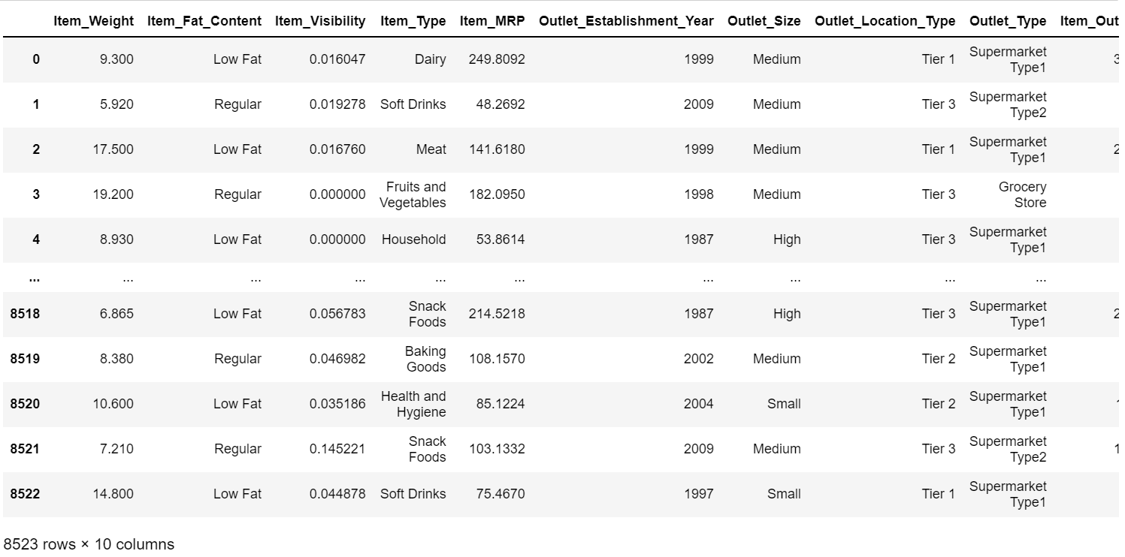
DATASET
The dataset was taken from Kaggle. It has 2 files Train.csv and Test.csv. The Train.csv and Test.csv file have 12 columns and 8523 rows. The columns give information about the item and outlet. These information will help us create a model which will predict the outlet sales of a particular product.

Slide 6
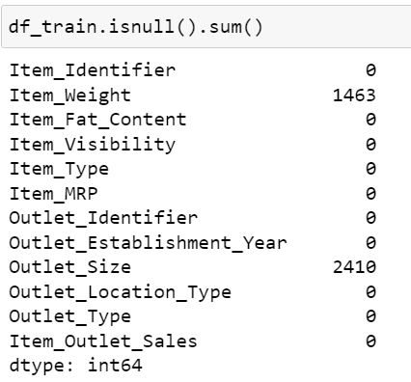
DATA CLEANING
First we check if we have any columns with null values
Here we can see that item_weight and outlet_size have null
values.
To clean this and remove the null values we will replace the
null values with the mean of the same column for item_weight
For Outlet_size we fill the null values with the mode of the same column

Slide 7
DATA CLEANING
We dropped Item_identifier and Outlet identifier from both Train and Test files because they are of no significance to us.

Slide 8
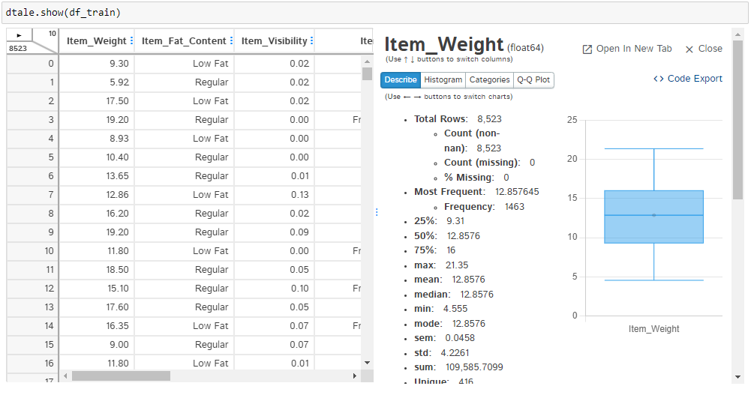
DATA ANALYSIS
DTALE
It is the combination of a Flask back-end and a React front-end to bring you an easy way to view & analyze Pandas data structures. It integrates seamlessly with ipython notebooks & python/ipython terminals. Currently this tool supports such Pandas objects as DataFrame, Series, MultiIndex, DatetimeIndex & RangeIndex.
By running this line of code: dtale.show(df_train)
We get a very elaborate picture of our dataset

Slide 9
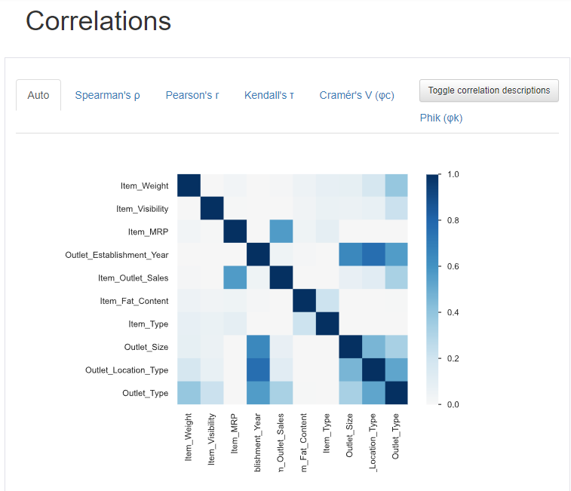
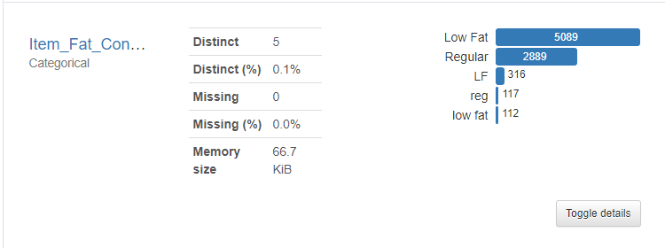
PandasProfiling
pandas-profiling generates profile reports from a pandas DataFrame. The pandas df.describe() function is handy yet a little basic for exploratory data analysis. pandas-profiling extends pandas DataFrame with df.profile_report(), which automatically generates a standardized univariate and multivariate report for data understanding.

Slide 10
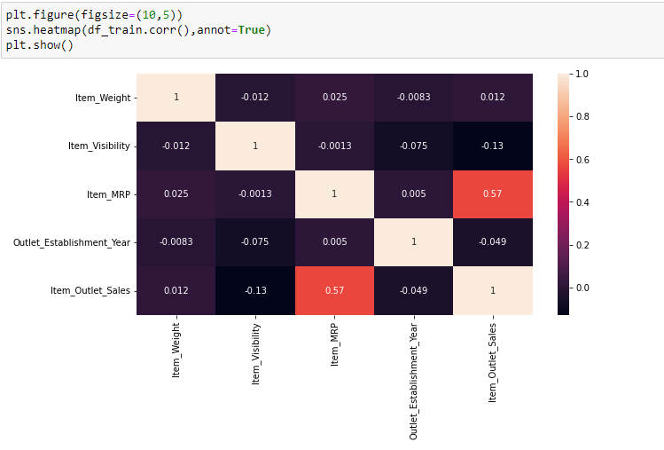
HEAT MAP
Heat map for figuring out the relationships between the dataset's characteristics.
Here, the correlation between the target variable and the other qualities is shown using a heat map, a color-coded matrix from the Seaborn data visualization toolkit.
The target variable's dependence on an attribute decreases as the color intensity of the attribute's relative to the target variable increases.

Slide 11
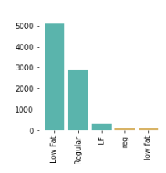
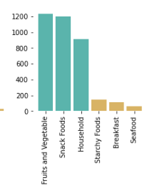
CATEGORIAL DATA PLOTS
The distribution of various Item fat content i.e., Low Fat and Regular Fat are written in distinct ways in the categorial data plots. It is observed that maximum items have low fat content.
The following figure shows how each item kind is distributed. Fruits and vegetables make up the majority of the goods, followed by snack foods. Seafood, in comparison, is least in number.

Slide 12
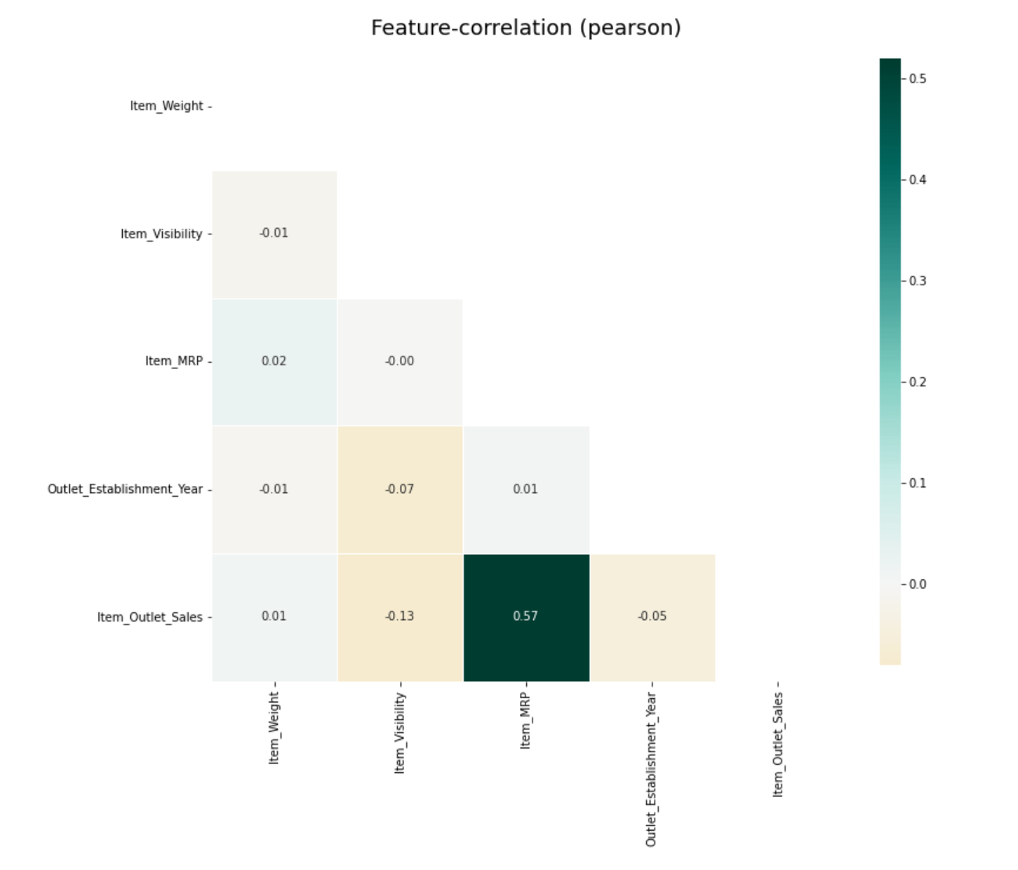
FEATURE-CORRELATION PLOTS
Correlation plots are used to understand which variables are connected to each other and the strength of this relationship. A correlation plot often has a number of numerical variables, with each variable represented by a column. The relationships between each pair of variables are shown by the rows. Positive values indicate a positive association, while negative values indicate a negative relationship. The values in the cells represent the strength of the relationship. You may use correlation heatmaps to identify possible links between variables and to gauge how strong these associations are.

Slide 13
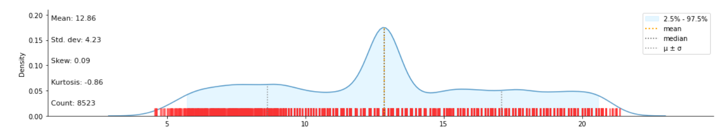
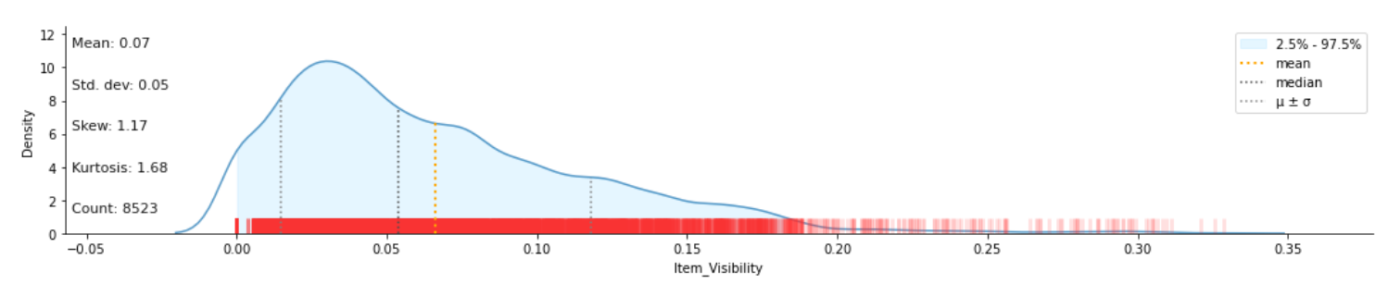
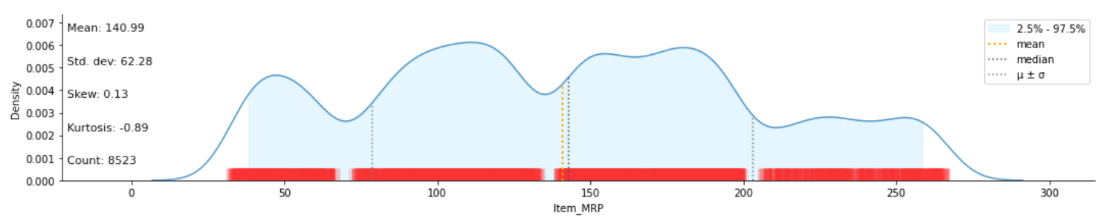
DISTRIBUTION PLOTS
Distribution plots visually analyze the distribution of sample data by comparing the data's actual distribution to the theoretical values anticipated from a certain distribution. To ascertain if the sample data belongs to a certain distribution, use distribution plots in addition to more formal hypothesis testing. The mean, median, standard deviation, and other statistics are also provided.

Slide 14
KLIB
A Python tool called Klib offers incredible flexibility for quickly studying your data. You can use this library if you think that data exploration is time-consuming because it includes all the functions you need to explore, clean, and prepare your data.
# klib.describe - functions for visualizing datasets
- klib.cat_plot(df) # returns a visualization of the number and frequency of categorical features
- klib.corr_mat(df) # returns a color-encoded correlation matrix
- klib.corr_plot(df) # returns a color-encoded heatmap, ideal for correlations
- klib.dist_plot(df) # returns a distribution plot for every numeric feature
- klib.missingval_plot(df) # returns a figure containing information about missing values
# klib.clean - functions for cleaning datasets
- klib.data_cleaning(df) # performs datacleaning (drop duplicates & empty rows/cols, adjust dtypes,...)
- klib.clean_column_names(df) # cleans and standardizes column names, also called inside data_cleaning()
- klib.convert_datatypes(df) # converts existing to more efficient dtypes, also called inside data_cleaning()
- klib.drop_missing(df) # drops missing values, also called in data_cleaning()
- klib.mv_col_handling(df) # drops features with high ratio of missing vals based on informational content
- klib.pool_duplicate_subsets(df) # pools subset of cols based on duplicates with min. loss of information

Slide 15

scikit-learn
A free machine learning library for the Python programming language is called scikit-learn. Support-vector machines, random forests, gradient boosting, k-means, and DBSCAN are just a few of the classification, regression, and clustering algorithms it offers. It is also built to work with Python's NumPy and SciPy scientific and numerical libraries.

Slide 16

FLASK
Flask is a micro web framework written in Python. It is classified as a microframework because it does not require particular tools or libraries. It has no database abstraction layer, form validation, or any other components where pre-existing third-party libraries provide common functions. However, Flask supports extensions that can add application features as if they were implemented in Flask itself. Extensions exist for object-relational mappers, form validation, upload handling, various open authentication technologies and several common framework related tools.

Slide 17

HTML
The preferred markup language for documents intended to be viewed in a web browser is HTML, or HyperText Markup Language. Technologies like Cascading Style Sheets (CSS) and scripting languages like JavaScript can help.
Web browsers download HTML documents from a web server or local storage, and then they transform the data into multimedia web pages. HTML originally included design hints for the document and describes the semantics of a web page's structure.

Slide 18
SUMMARY
Demand forecasting is one of the major challenges faced by supply chains in the retail sector when trying to maximize stock levels, save costs, and boost revenue, profits, and customer loyalty. The solution to this problem is to examine and understand complex relationships and pat-terns from historical data using techniques like time series analysis and machine learning. In other words, it is critical to have the capability to determine what customers will buy, when they'll need it, and how much they will demand from a specific retailer or store.

Slide 19
THANK YOU

